Slide 1
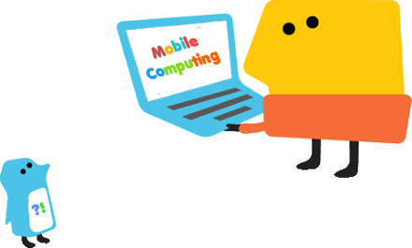
Introduction to Mobile Computing

Slide 2
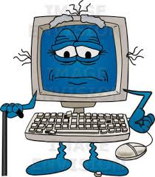
What is Computing
Computing is any goal-oriented activity requiring, benefiting from, or creating algorithmic processes—e.g. through computers.
Computing includes
designing, developing and building hardware and software systems;
processing, structuring, and managing various kinds of information;
doing scientific research on and with computers;
making computer systems behave intelligently;
and creating and using communications and entertainment media.

Slide 3
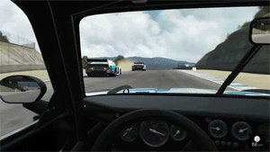
Computing
Using computers to accomplish tasks that are usually time consuming or not possible by humans

Slide 4
Computing
Uses
Business
Education
Entertainment
Home
Medical
The most commonly used feature in all of this is Communication ie. Networks

Slide 5
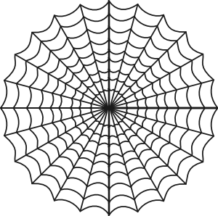
Networks
The term networks/web is derived from the spiders web
The web is nothing but a series of interconnected computers
These interconnected computers are
Also called as networks

Slide 6
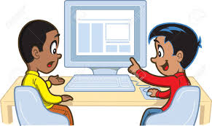
Networks
In 1961 Defense Advanced Research Projects Agency developed ARPANET
This ARPANET was only used for research purposes and other confidential purposes

Slide 7
Networks
Hmmm what happens if I send an email ????

Slide 8
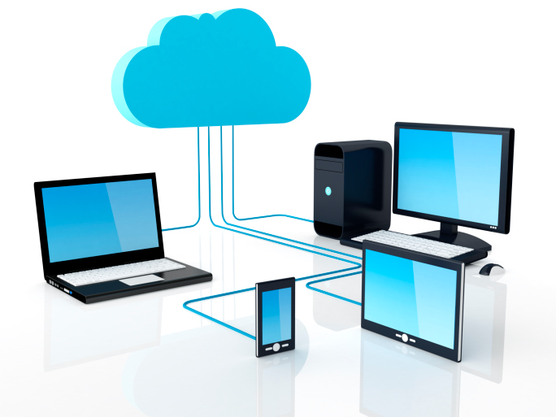
Networks
Packets Switching ☺
A transaction breaking into packets

Slide 9
Mobile Networks
Mobile networks have evolved from being very basic to what it is now and what it would be in the future
This evolution is clearly categorized into generations
Each generation has a specific technology attached to it

Slide 10
Mobile Computing
Mobile Computing refers a technology that allows transmission of data, voice and video via a computer or any other wireless enabled device.
It is free from having a connection with a fixed physical link.
It facilitates the users to move from one physical location to another during communication.

Slide 11
Mobile Computing is a technology that provides an environment that enables users to transmit data from one device to another device without the use of any physical link or cables.
In other words, you can say that mobile computing allows transmission of data, voice and video via a computer or any other wireless-enabled device without being connected to a fixed physical link.
In this technology, data transmission is done wirelessly with the help of wireless devices such as mobiles, laptops etc.

Slide 12
This is only because of Mobile Computing technology that you can access and transmit data from any remote locations without being present there physically.
Mobile computing technology provides a vast coverage diameter for communication.
It is one of the fastest and most reliable sectors of the computing technology field.
The concept of Mobile Computing can be divided into three parts:
Mobile Communication
Mobile Hardware
Mobile Software

Slide 13
Mobile Communication
Mobile Communication specifies a framework that is responsible for the working of mobile computing technology.
In this case, mobile communication refers to an infrastructure that ensures seamless and reliable communication among wireless devices.
This framework ensures the consistency and reliability of communication between wireless devices.
The mobile communication framework consists of communication devices such as protocols, services, bandwidth, and portals necessary to facilitate and support the stated services.
These devices are responsible for delivering a smooth communication process

Slide 15
For Example, Desktop Computer.
For Example, Communication Towers, WiFi router
For Example, Laptops.
For Example, WiFi Dongle.

Slide 16
Mobile Hardware
Mobile hardware consists of mobile devices or device components that can be used to receive or access the service of mobility.
Examples of mobile hardware can be smartphones, laptops, portable PCs, tablet PCs, Personal Digital Assistants, etc.
These devices are inbuilt with a receptor medium that can send and receive signals.
These devices are capable of operating in full-duplex.
It means they can send and receive signals at the same time. They don't have to wait until one device has finished communicating for the other device to initiate communications.

Slide 17
Mobile Software
Mobile software is a program that runs on mobile hardware.
This is designed to deal capably with the characteristics and requirements of mobile applications.
This is the operating system for the appliance of mobile devices. In other words, you can say it the heart of the mobile systems.
This is an essential component that operates the mobile device.

Slide 34
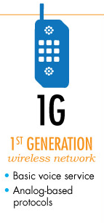
Generation of Mobile Networks
1st Generation or 1G
Started early 1980s, Analog Cellular Phones
Designed purely for voice calls
No data services

Slide 35
Generation of Mobile Networks
2nd Generation or 2G
digital cellular systems, early 1990s,
offering improved sound quality, better security and higher total capacity.
GSM supports circuit-switched data

Slide 36
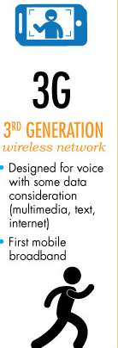
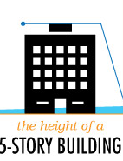
Generation of Mobile Networks
3rd Generation or 3G
Video Telephony / Internet Surfing
Data and Voice work together
HSPA – High Speed Packet Access

Slide 37
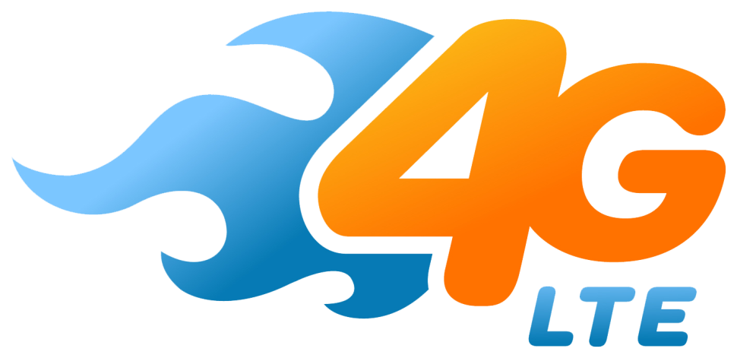
Generation of Mobile Networks
4th Generation or 4G
Interoperability/ Enhanced 3
High-speed IP based
Packet Switching

Slide 38
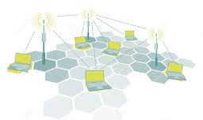
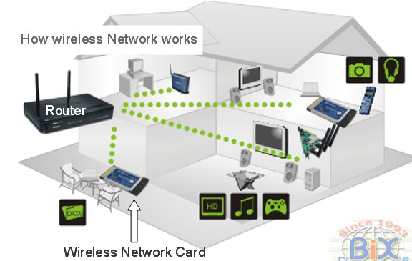
Wireless Networks

Slide 39
Cellular Networks
It’s a network based on radio signals which is distributed over land areas called cells.
Each cell is served with a base station, with different frequencies to avoid interference
The process of transferring an ongoing call or data session is called a Handoff or Handover
Mobile Networks:
GSM – Global Standard for Mobile communications
CDMA – Code Division Multiple Access
UMTS – Universal Mobile Telecommunications System
WiMAX – Worldwide interoperability for Microwave Access
LTE – Long Term Evolution

Slide 40
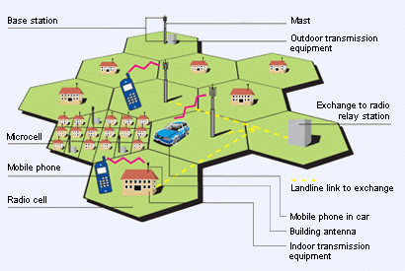
Wireless Networks

Slide 41
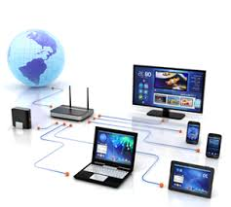
Mobile Computing
Mobile computing is not related to mobile phones alone

